Slide 1
RB Bank
Written in Java Eclipse

Slide 2
Structure
Data stored in Postgresql database
Data access performed through JDBC in a layer of Data Access Object (DAO) objects
Input with java.util.Scanner
Logged with Log4j
Junit tests

Slide 3
Features
Can register for customer account
Can login
Can apply for new bank account with starting balance
Can view balance of an account
Can make a withdrawal or deposit
Invalid transactions rejected

Slide 4
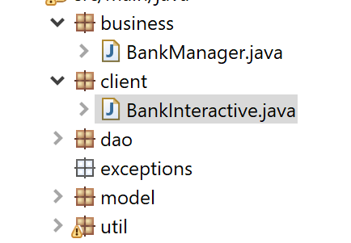
Different layers of code

Slide 5
Naming Conventions Followed
Class names begin with capital letters
Package names begin with small letters
Method names written in camel case
Variable names written in camel case

Slide 6
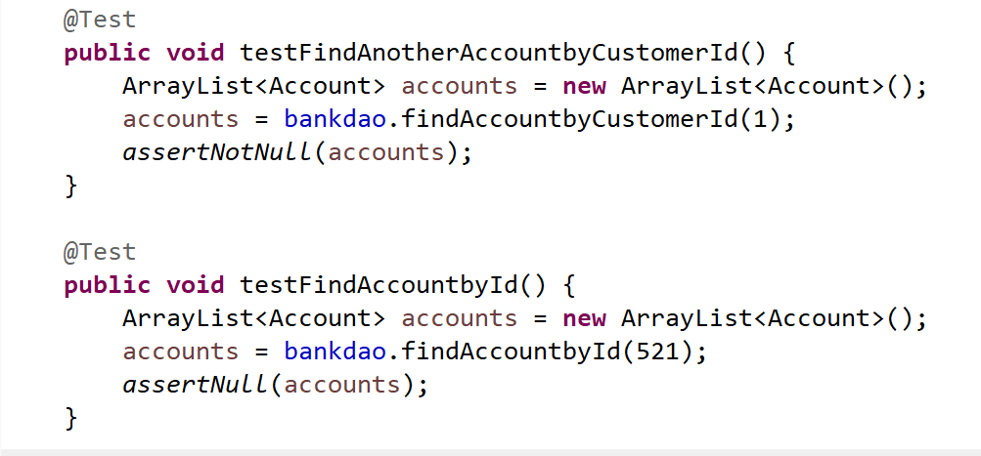
Junit Testing Used

Slide 7
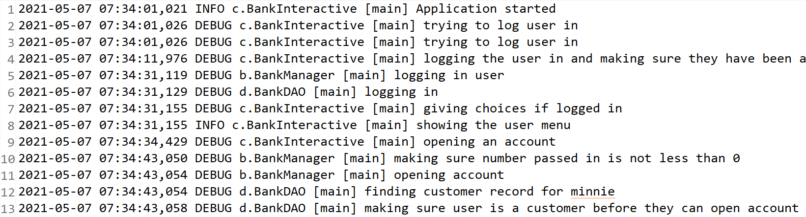
Logging was used, too

Slide 8
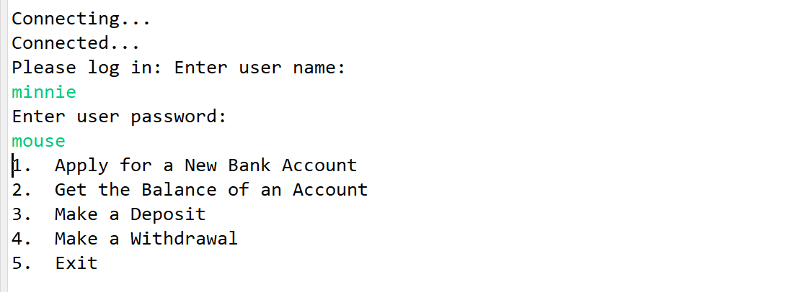
Logging in - Successful

Slide 9
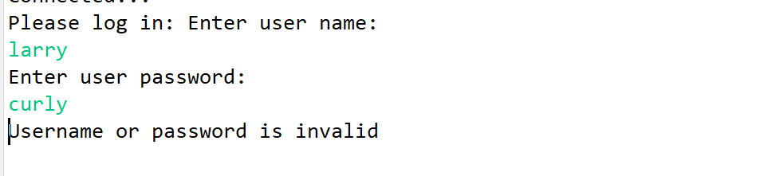
Logging in - Unsuccessful

Slide 10
Thank you

